Slide 1
Quick intro to Data Science R Quick-start
Sinai Data Science
2/1/2018

Slide 2
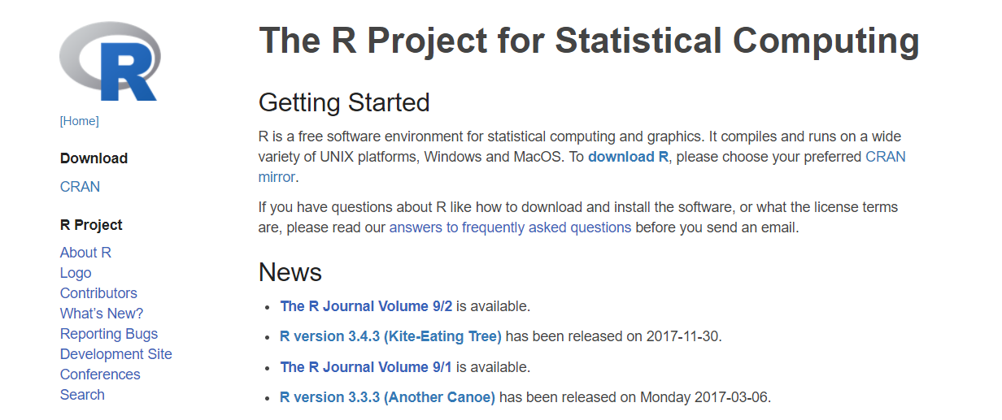
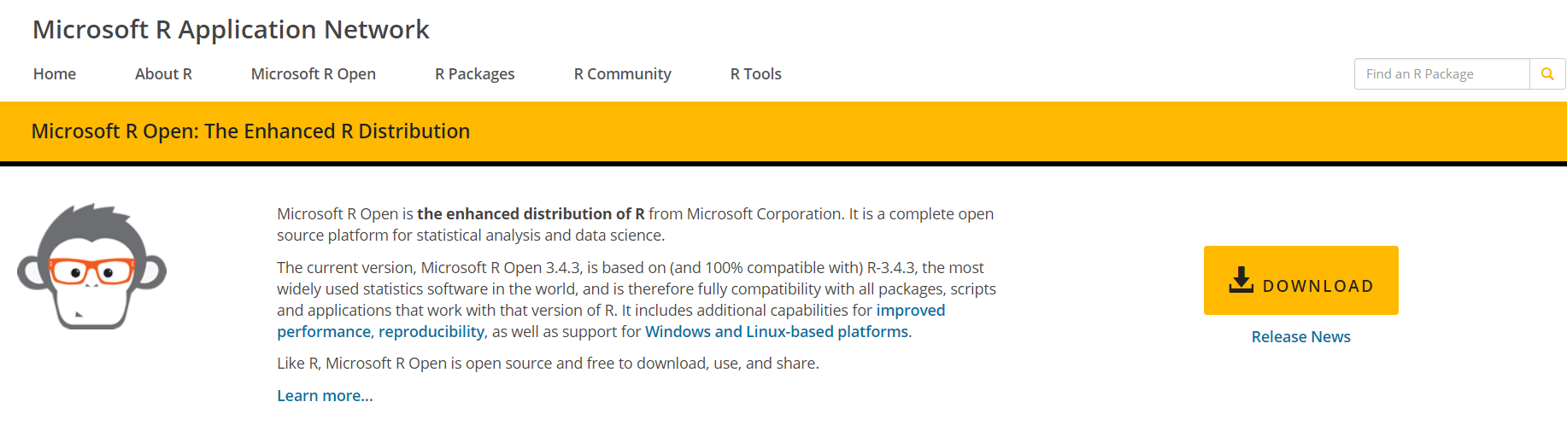
R installation and configuration
1: Install the R programming language:
Either one is fine

Slide 3
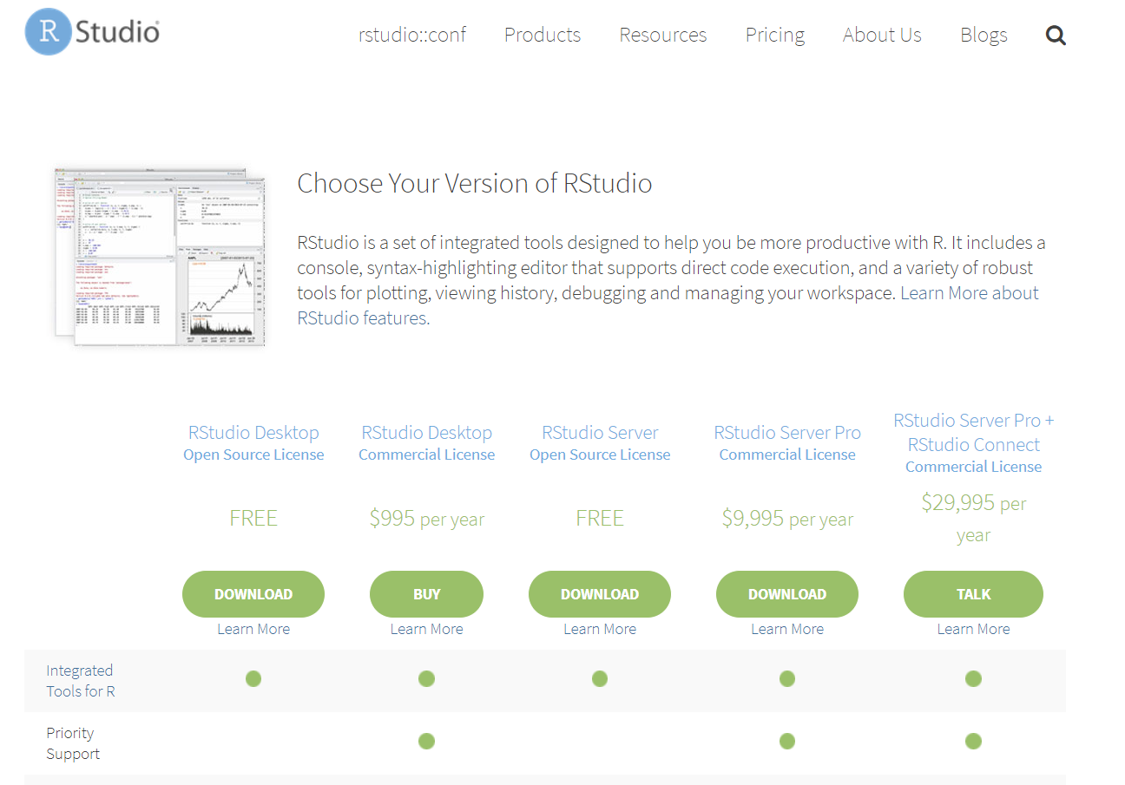
R installation and configuration
2: Install Rstudio

Slide 4
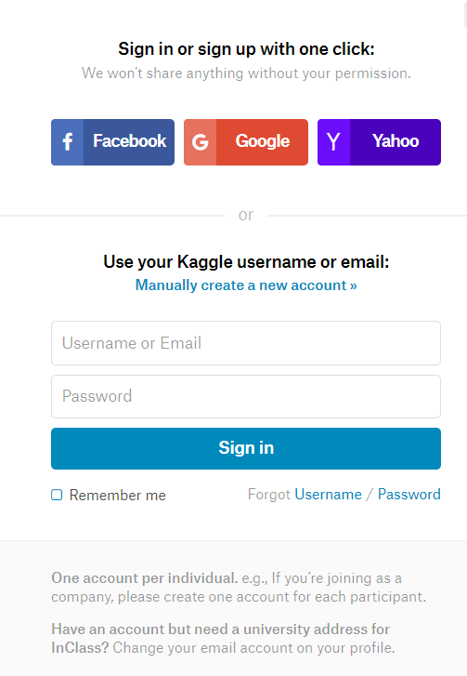

Set up kaggle account
Use your Icahn.MSSM.edu email

Slide 5

Can we predict whether a passenger survived the titanic?

Slide 6

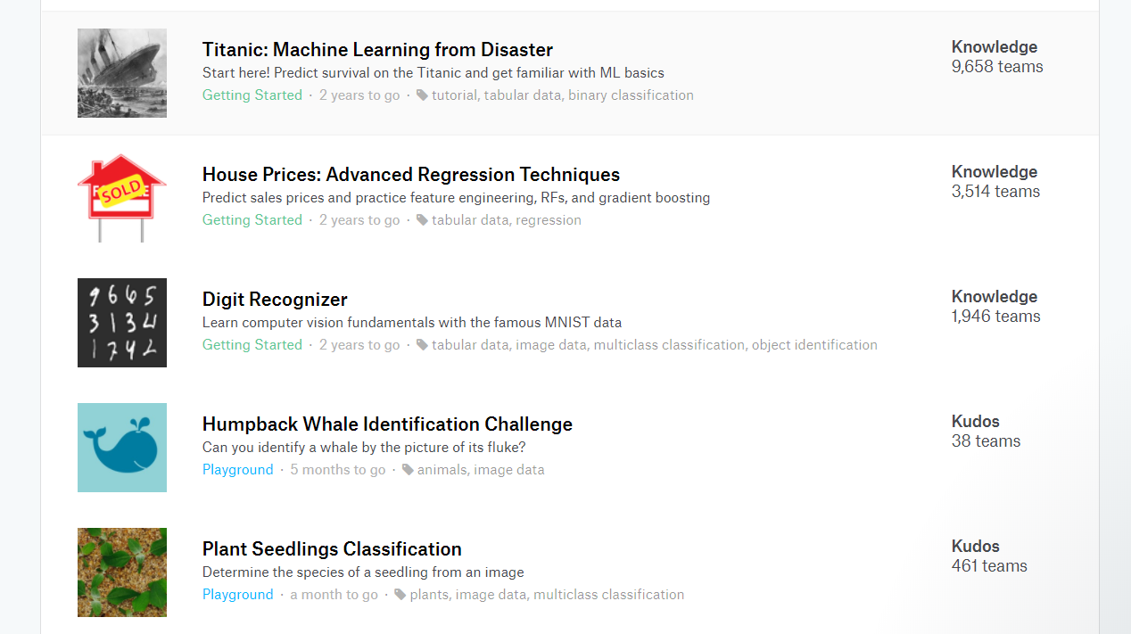
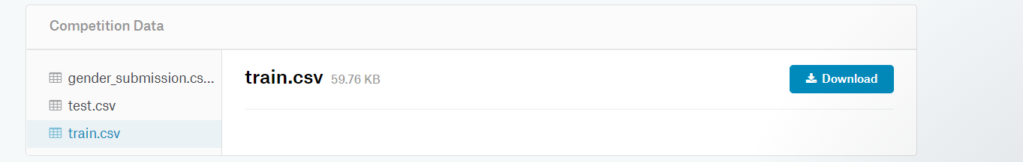
Obtain titanic data
Download both test and train sets

Slide 7
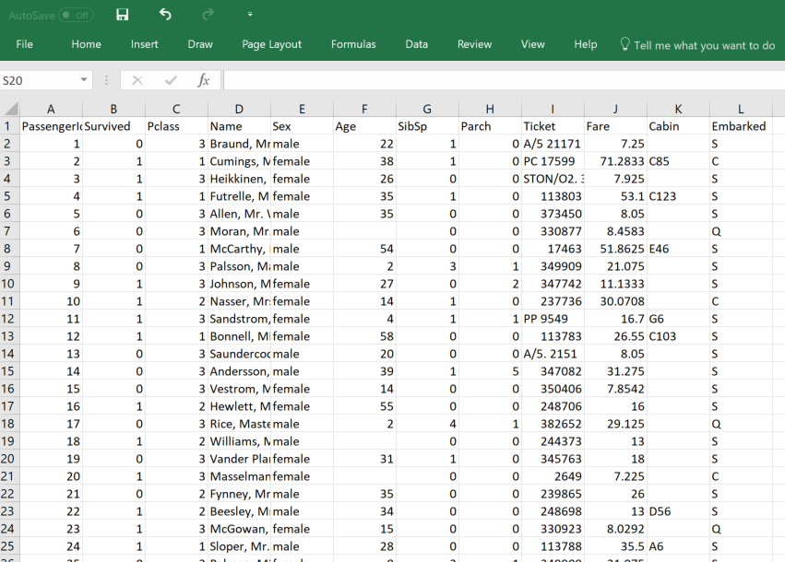
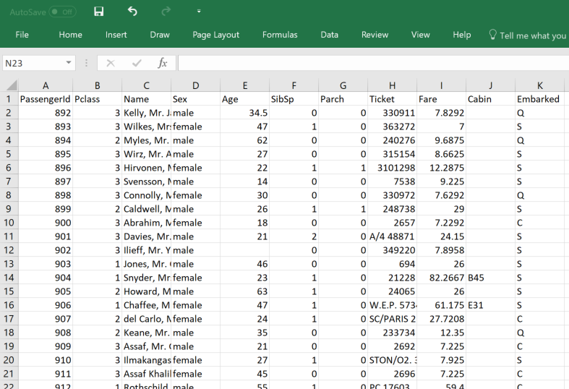
Open the files in excel:
1. Spot the difference
Train
Test

Slide 8
Open the files in excel:
2. What type of feature is ‘Survived’ ?
Train
Test

Slide 9
Open the files in excel:
3. Are there any other ways of thinking about ‘Survived’ ?
Train
Test

Slide 10
Intro to R: Opening files
First function:
read.csv(FILE,HEADER, ROW.NAMES,COLUMN.NAMES)

Slide 11
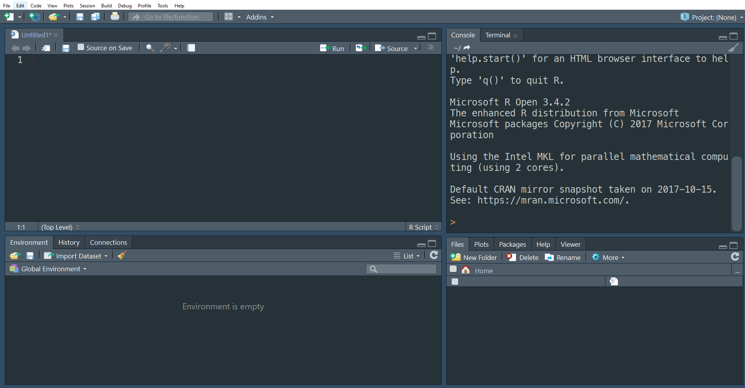
Intro to R: Opening files
When your commands run
read.csv(“train.csv”, header = T,)

Slide 12
Intro to R: Opening files
Assigning operator
When your commands run
train = read.csv(“train.csv”, header = T,)
your variable
Where your plots show up

Slide 13
Intro to R: Opening files
To send the command to the console use ‘CTRL+ENTER’
train = read.csv(“train.csv”, header = T,)

Slide 14
Intro to R: Opening files
When your commands run
Scripting Area
Where your plots show up
Where your variables are

Slide 15
Intro to R: Working with dataframes
The variable train is called a dataframe
Dataframes are like tables: they have rows and columns
To view in it’s entirety dataframe you use the View function
Try:
View(train)
What do you get?

Slide 16
Intro to R: Working with dataframes
‘View’ is often times not the best way to view dataframes, especially if you have a lot of rows or columns.
We can use dataframe slices to better see snippets of the dataframe:
Lets say we want to see what is in the 10th column in the 15th row of the variable: ‘train’
To access values in a dataframe use this syntax:
dataframe_variable_name[row_number,column_number]

Slide 17
Intro to R: Working with dataframes
‘View’ is often times not the best way to view dataframes, especially if you have a lot of rows or columns.
We can use dataframe slices to better see snippets of the dataframe:
Lets say we want to see what is in the 10th column in the 15th row of the variable: ‘train’
To access values in a dataframe use this syntax:
dataframe_variable_name[row_number,column_number]
Train[15,10]
How would we store this output value?

Slide 18
Intro to R: Working with dataframes
‘View’ is often times not the best way to view dataframes, especially if you have a lot of rows or columns.
We can use dataframe slices to better see snippets of the dataframe:
Lets say we want to see what is in the 10th column in the 15th row of the variable: ‘train’
To access values in a dataframe use this syntax:
dataframe_variable_name[row_number,column_number]
train[15,10]
How would we store this output value?
v = train[15,10]
What type of variable is ’v’ ?

Slide 19
types of variables in r
Vectors
The most basic type of variable in R:
Variable ‘v’ is a vector
Vectors can be a single value or can be an array (think ‘list’) of values
Elements in a vector have different properties:
Numeric, Character, Factor, etc.
To define a vector use : ‘c()’
Define a variable q, where q contains numbers: 1,2,3,4,5,6,7

Slide 20
types of variables in r
Vectors
The most basic type of variable in R:
Variable ‘v’ is a vector
Vectors can be a single value or can be an array (think ‘list’) of values
Elements in a vector have different properties:
Numeric, Character, Factor, etc.
To define a vector use : ‘c()’
Define a variable q, where q contains numbers: 1,2,3,4,5,6,7
q = c(1,2,3,4,5,6,7)
How would you access the 6th number in this vector?

Slide 21
types of variables in r
Vectors
The most basic type of variable in R:
Variable ‘v’ is a vector
Vectors can be a single value or can be an array (think ‘list’) of values
Elements in a vector have different properties:
Numeric, Character, Factor, etc.
To define a vector use : ‘c()’
Define a variable q, where q contains numbers: 1,2,3,4,5,6,7
q = c(1,2,3,4,5,6,7)
How would you access the 6th number in this vector?
q[6]

Slide 22
Working with dataframes
Vectors
The most basic type of variable in R:
Variable ‘v’ is a vector
Vectors can be a single value or can be an array (think ‘list’) of values
Elements in a vector have different properties:
Numeric, Character, Factor, etc.
To define a vector use : ‘c()’
Define a variable q, where q contains numbers: 1,2,3,4,5,6,7
q = c(1,2,3,4,5,6,7)
How would you access the 6th number in this vector?
q[6]
Another way to get the sequence of numbers from 1-7 is to use ‘:’

Slide 23
Working with dataframes
Vectors
Another way to get the sequence of numbers from 1-7 is to use ‘start:stop’
q = c(1:7)
How would we get elements 3-5 from ‘q’ ?

Slide 24
Working with dataframes
Vectors
Another way to get the sequence of numbers from 1-7 is to use ‘start:stop’
q = c(1:7)
How would we get elements 3-5 from ‘q’ ?
q[3:5]
From ‘train’ how would we get rows 10 to 15 and columns 1 to 4?

Slide 25
Working with dataframes
Vectors
Another way to get the sequence of numbers from 1-7 is to use ‘start:stop’
q = c(1:7)
How would we get elements 3-5 from ‘q’ ?
q[3:5]
From ‘train’ how would we get rows 10 to 15 and columns 1 to 4?
train[10:15, 1:4]
How about getting rows 15 to 30 and all columns?

Slide 26
Working with dataframes
Vectors
Another way to get the sequence of numbers from 1-7 is to use ‘start:stop’
q = c(1:7)
How would we get elements 3-5 from ‘q’ ?
q[3:5]
From ‘train’ how would we get rows 10 to 15 and columns 1 to 4?
train[10:15, 1:4]
How about getting rows 15 to 30 and all columns?
Leave the columns section blank
Train[15:30, ]
What about getting all row and showing columns 1 to 3?

Slide 27
Working with dataframes
Vectors
Another way to get the sequence of numbers from 1-7 is to use ‘start:stop’
q = c(1:7)
How would we get elements 3-5 from ‘q’ ?
q[3:5]
From ‘train’ how would we get rows 10 to 15 and columns 1 to 4?
train[10:15, 1:4]
How about getting rows 15 to 30 and all columns?
Leave the columns section blank
Train[15:30, ]
What about getting all row and showing columns 1 to 3?
Train[ , 1:3]

Slide 28
Working with dataframes
Lets say that I store the output of train[10:15, 1] in a variable ‘d’, what type of variable is ‘d’:
That is:
d = train[10:15,1]

Slide 29
Working with dataframes
Lets say that I store the output of train[10:15, 1:4] in a variable ‘d’, what type of variable is ‘d’:
That is:
d = train[10:15,1:4]
‘d’ is a vector.

Slide 30
Working with dataframes
Special ways to access columns from dataframes:
IF your dataframe has a header, we can use the name of the specific column to get back the contents of the columns:
To do this we use the $ operator
train$Name
Is the same as:
train[,4]

Slide 31
Machine learning: Terminology
A bit about terminology:
We called the first line in this data set the ‘header’ and all subsequent lines: ‘rows’
In ML we need to distinguish a few things:
Rows are typically called instances, items, or examples
Columns are divided into three types:
ID: Usually the first column in the set, just gives an ID to a particular instance and does not contain any descriptive information about the example
Features: columns that describe the example, especially if they relate to a class
Class: is the column of feature we want to predict
Can you label the data on the right?

Slide 32
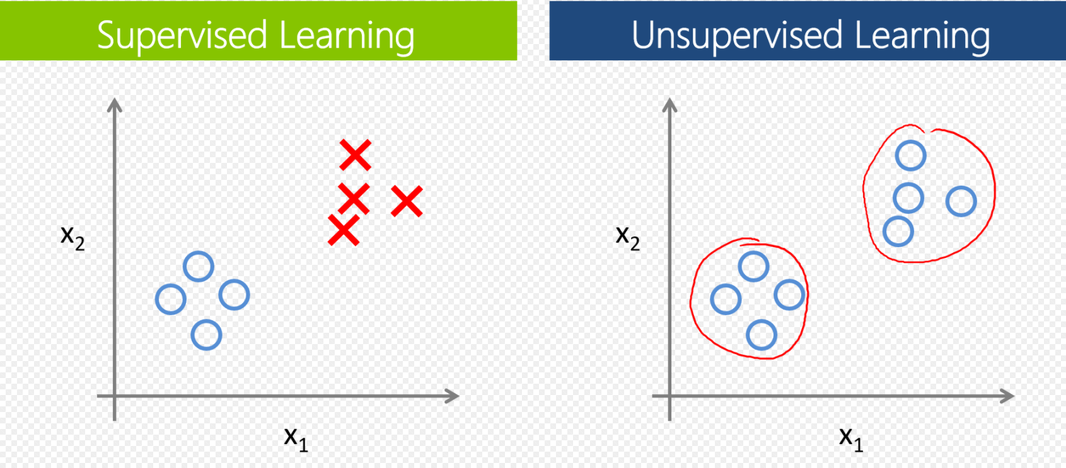
Machine learning: Unsupervised vs Supervised learning
A bit more on ML terminology:
Unsupervised Learning:
Goal is to find inherent or latent structures in your data
Can be used to define new groups within your data or cluster similar instances together or Dimensionality Reduction
Methods include: PCA, hierarchical clustering, autoencoders
Really cool example: “Objects that sound”
https://www.youtube.com/watch?v=TFyohksFd48
Learning to find where a sound comes from given a picture:
Supervised Learning:
Goal is to classify or predict the value of a feature based on descriptors
Artificial neural networks, Regression models
https://stanfordmlgroup.github.io/projects/chexnet/

Slide 33
Can we predict whether a passenger survived the titanic?

Slide 34
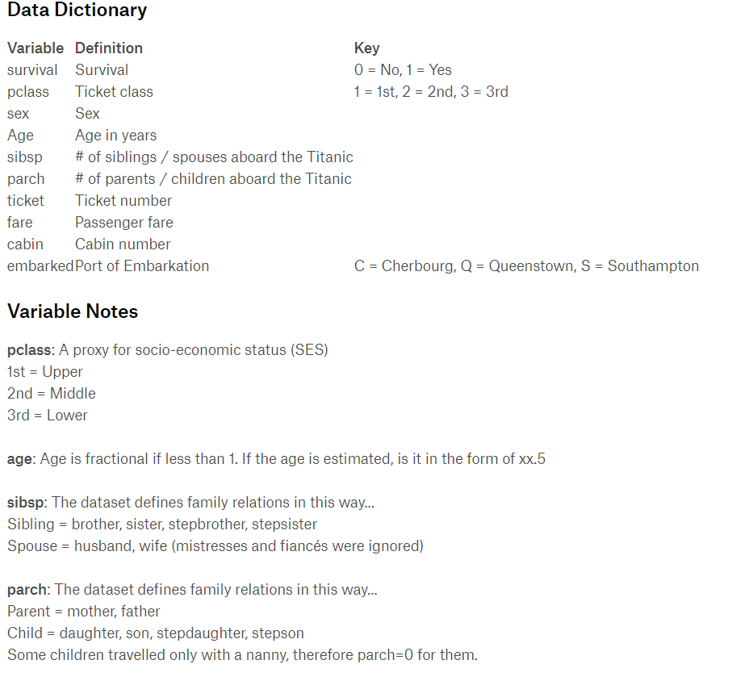
Machine Learning: Feature Selection
Lets take a look at the features of the titanic data set:
What do you think are features that are most predictive in determining whether or not a passenger survived?

Slide 35
Machine Learning: Feature Selection
Lets take a look at the features of the titanic data set:
What do you think are features that are most predictive in determining whether or not a passenger survived?
Lets make some plots!

Slide 36
Making sexy boxplots
The reason why R is such a popular data science language is because of packages
Packages are user made libraries for R that add functionality or make things in R easier
Lets compare the built in R plotting function with ggplot2
First we need to install the ggplot2 package using the command:
install.packages(‘ggplot2’)

Slide 37
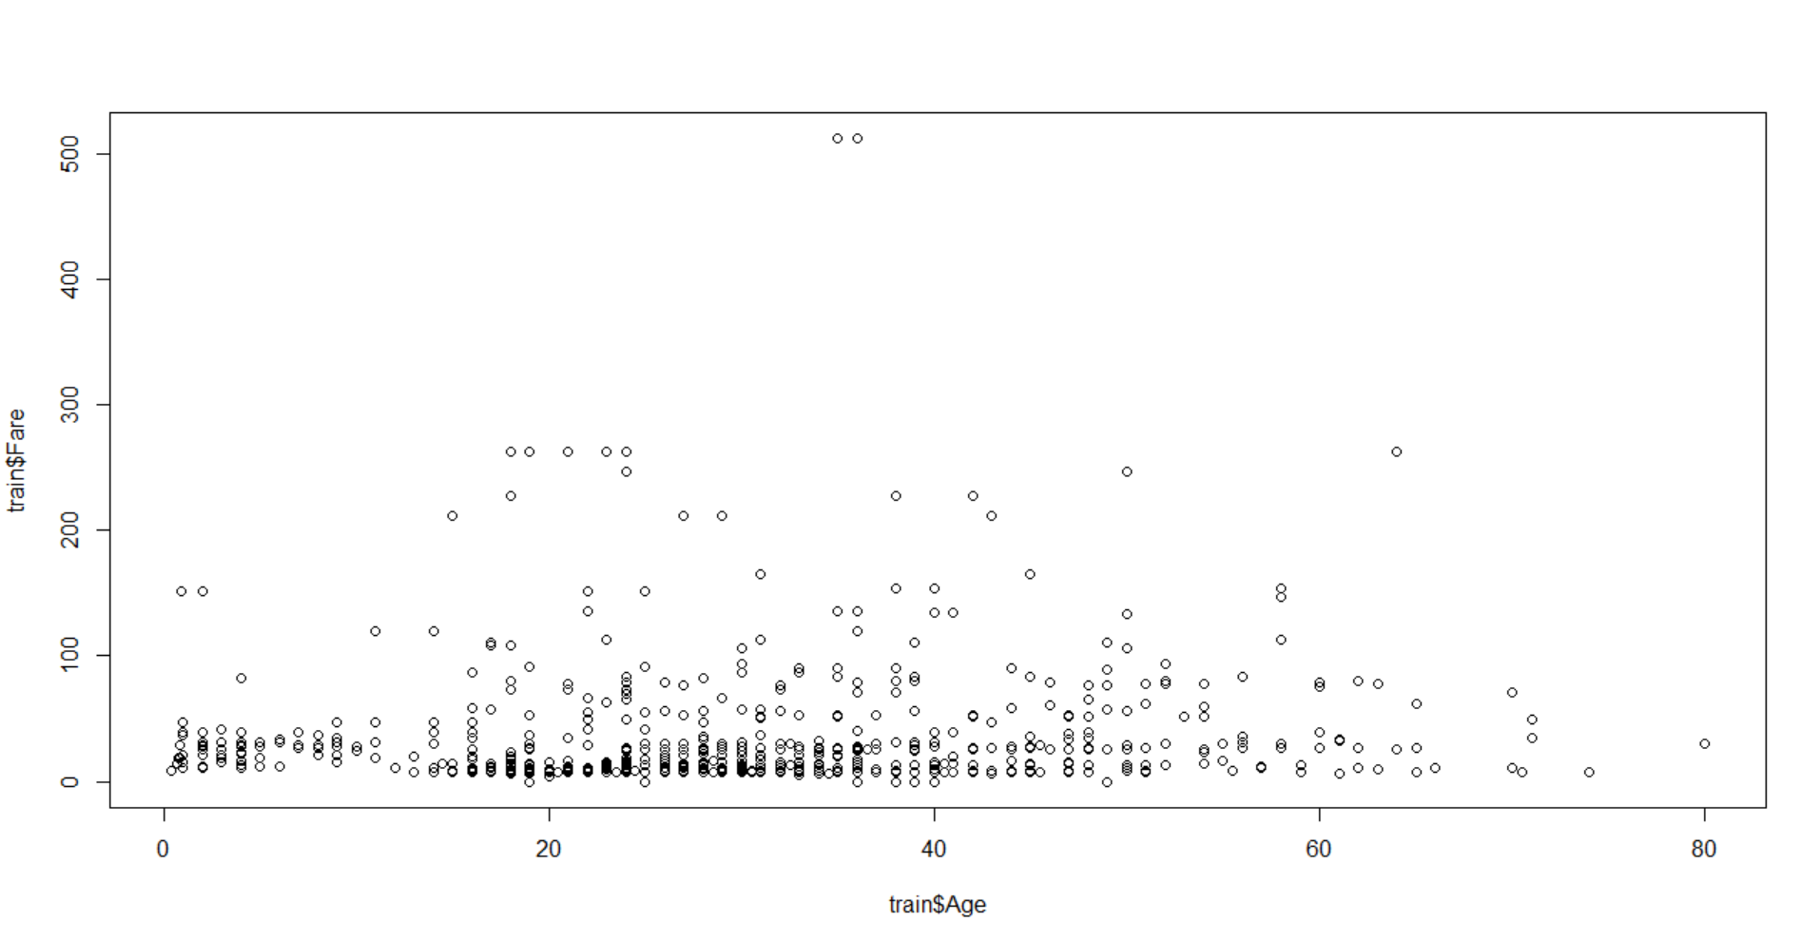
Making sexy boxplots
Next lets use the built in R plotting function: ‘plot’ to plot the age vs fare features in the ‘train’ dataframe:
plot( train$age, train$fare)
Gross AF
Now lets use ggplot

Slide 38
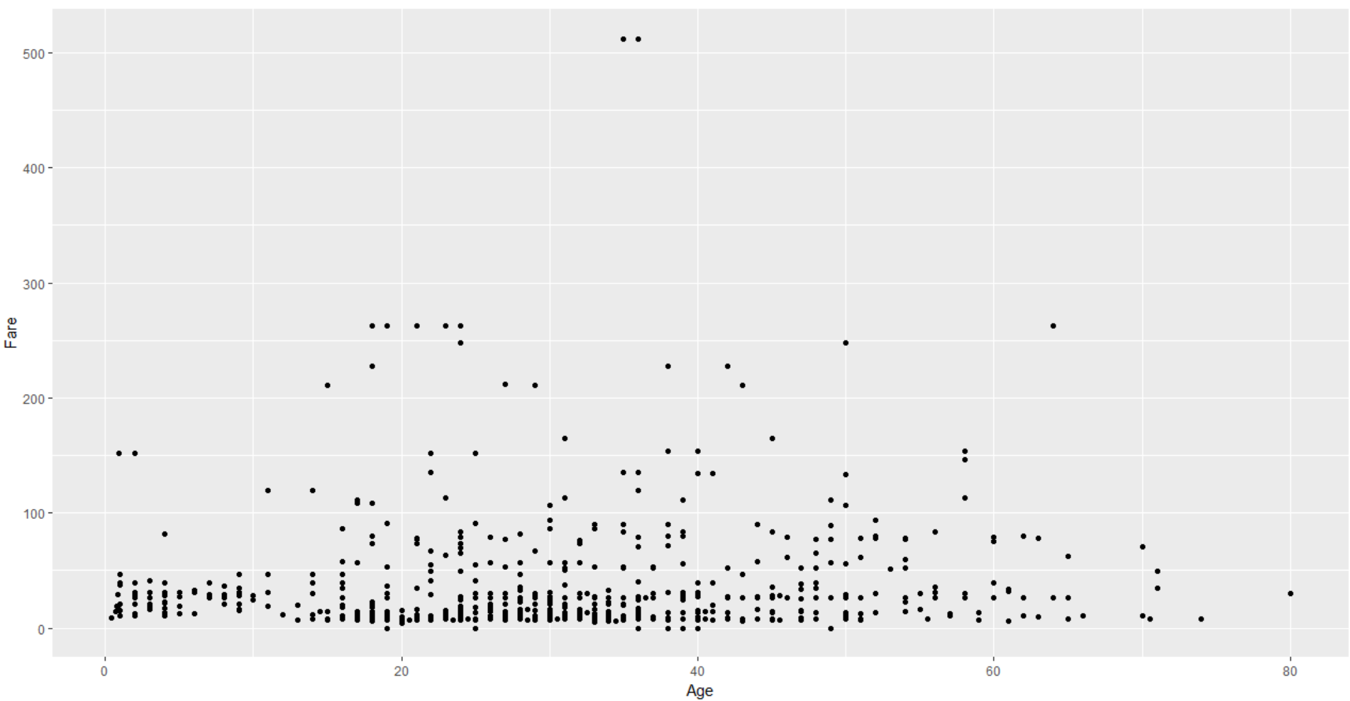
Making sexy boxplots
First we need to load the package:
Library(ggplot2)
Next we use ggplot syntax to generate the plot:
ggplot(train, aes(Age, Fare) ) + geom_point()

Slide 39
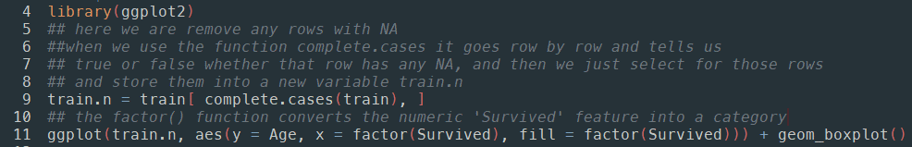
Making sexy boxplots
Now lets explore how each feature is associated with ‘survival’ using a boxplot and ggplot, lets look at age

Slide 40
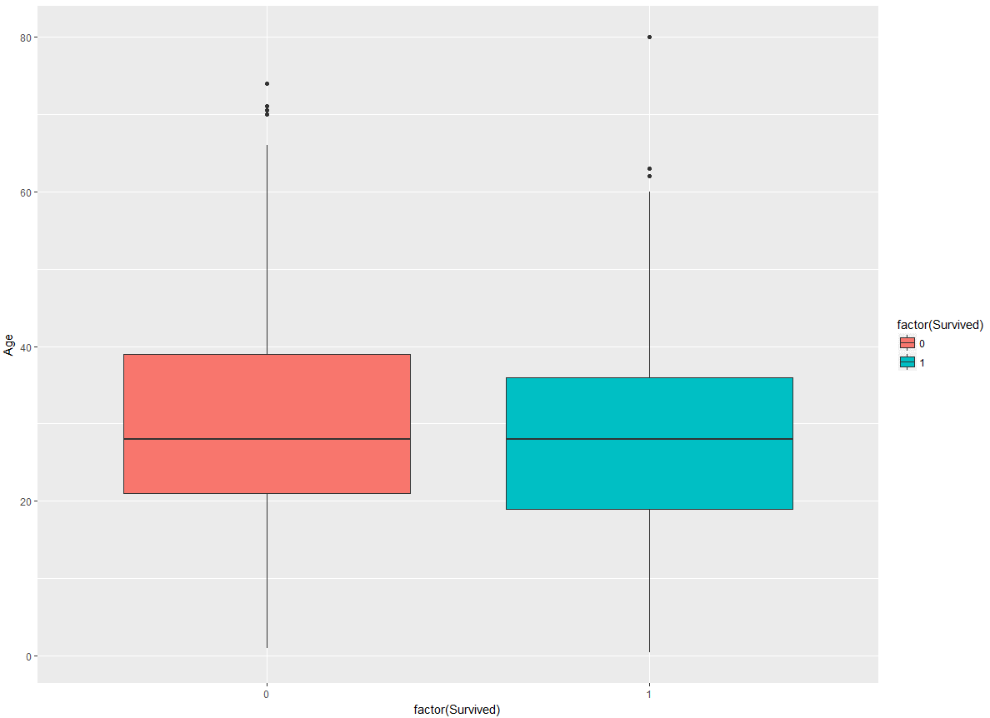
Is there are difference with age?

Slide 41
Making sexy boxplots
Even better lets explore how age is associated with survival using a violin plot!
Just change this

Slide 42
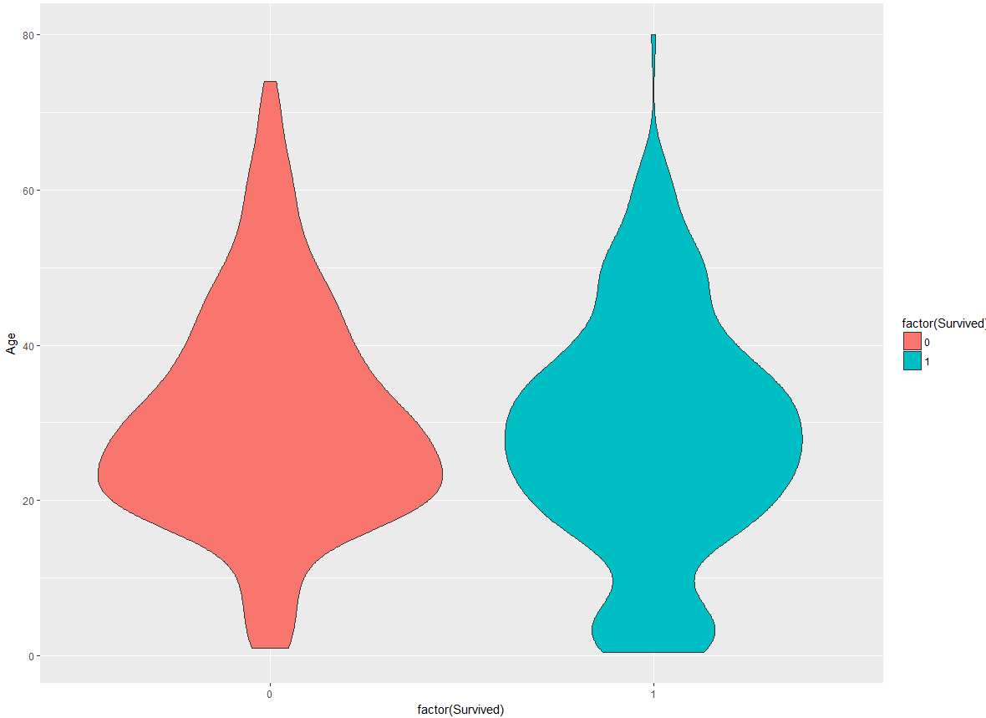
Is there are difference with age?

Slide 43
Making sexy boxplots
Now lets explore how each feature is associated with ‘survival’ using a violinplot and ggplot
Lets figure out which numeric features best explain survival

Slide 44
Feature selection
Now lets explore how each feature is associated with ‘survival’ using a violinplot and ggplot
Lets figure out which numeric features best explain survival
I found the following features:
Pclass
Fare

Slide 45
Next time:
Feature Creation:
Hint: look at the names of the passengers and try to see if there is a pattern
Clustering using kmeans
Classification using random forests

